Slide 1
Team 9
{Rupali,Sowmya}

Slide 2
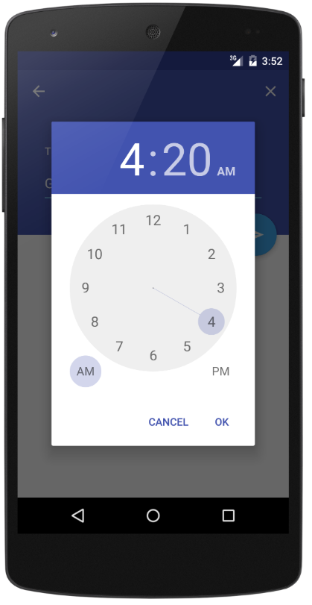
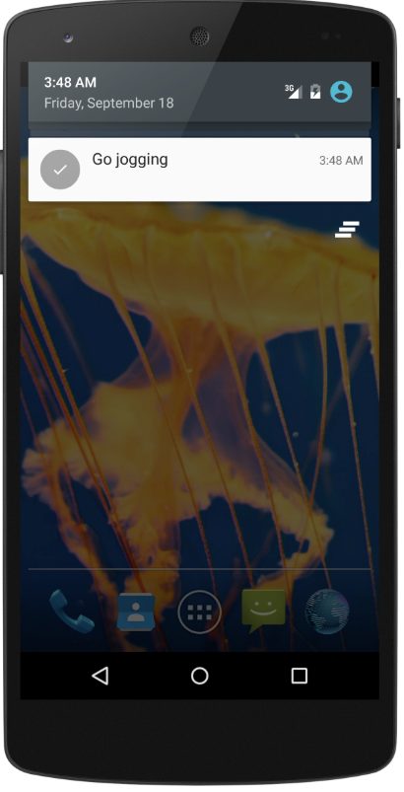
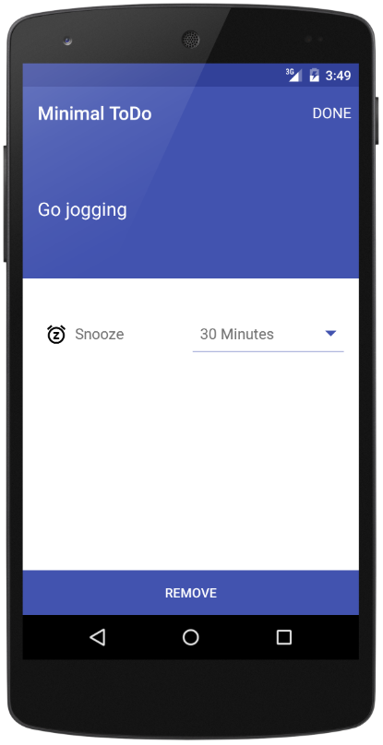
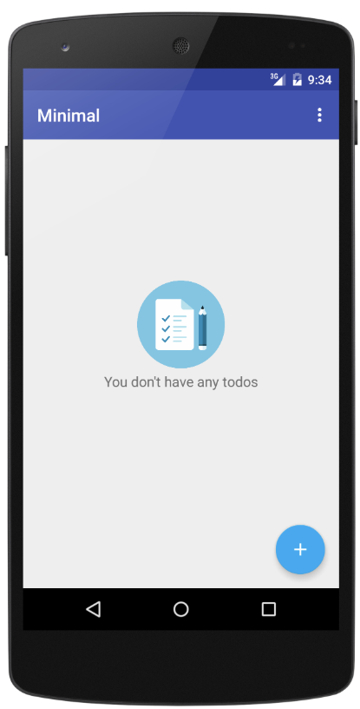
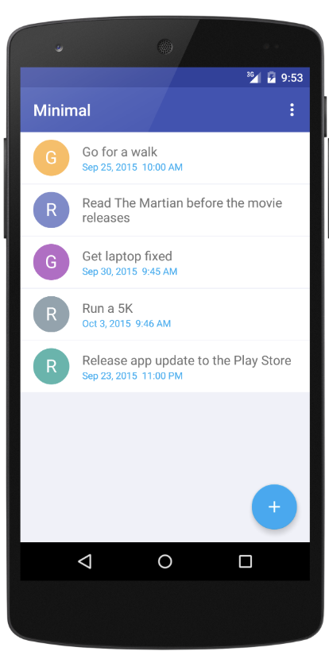
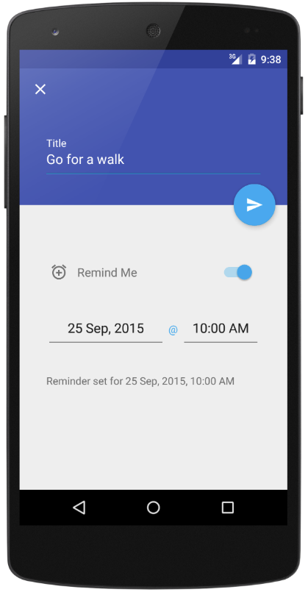
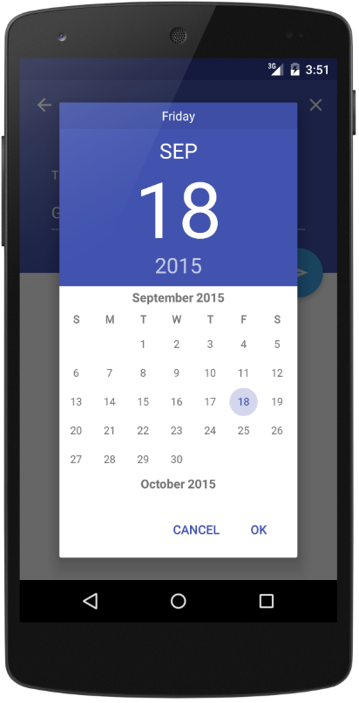
Android Minimal - TODO
https://github.com/avjinder/Minimal-Todo

Slide 3
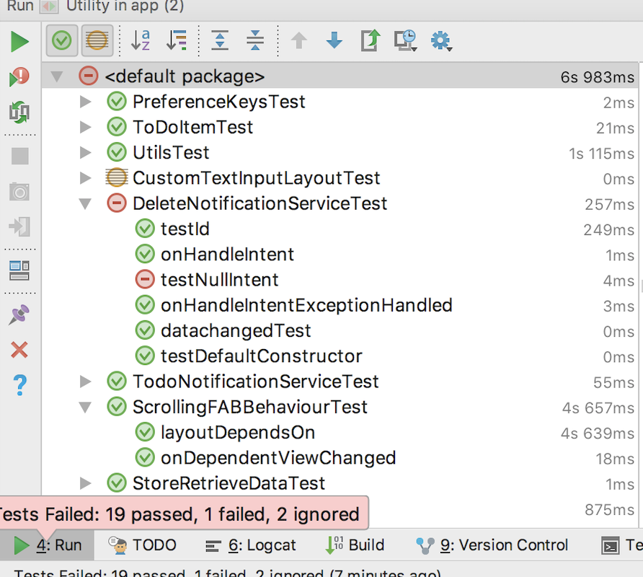
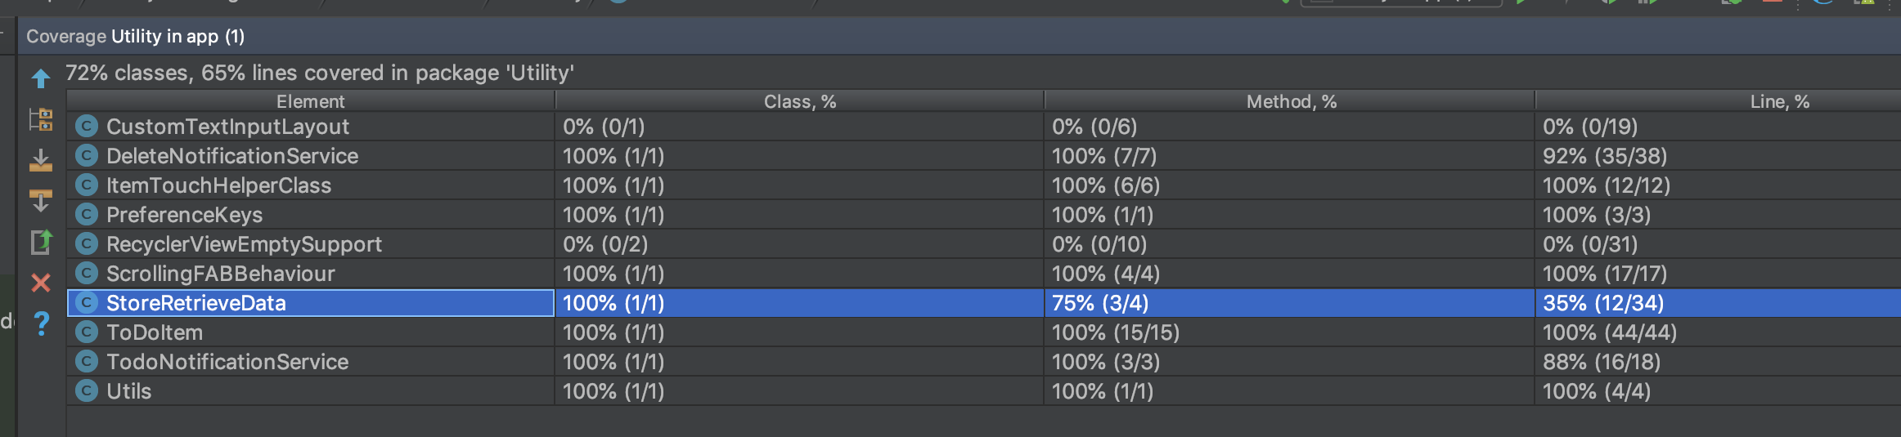
Unit Testing and Code Coverage
Unit Tests test the functionality of the code units. For our application
we took 1 package as the unit.
22 unit tests with failure cases and success cases. Used ‘mocks’,
‘fakes’ and stubs learnt in class.
21 tests passed and 1 failed.
Bad code without composition and injection prevents writing tests.
Use of android context without injection prevents test mocks from supplying
the needful data.
Used jacoco for coverage, existing bugs from UUID.java, JDK9 and jacoco fails the jacoco tests.

Slide 4
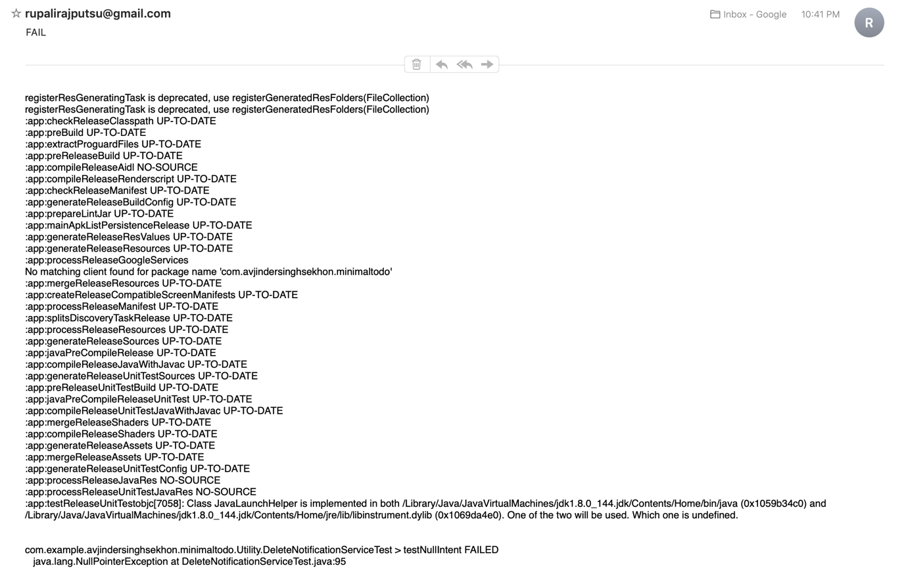
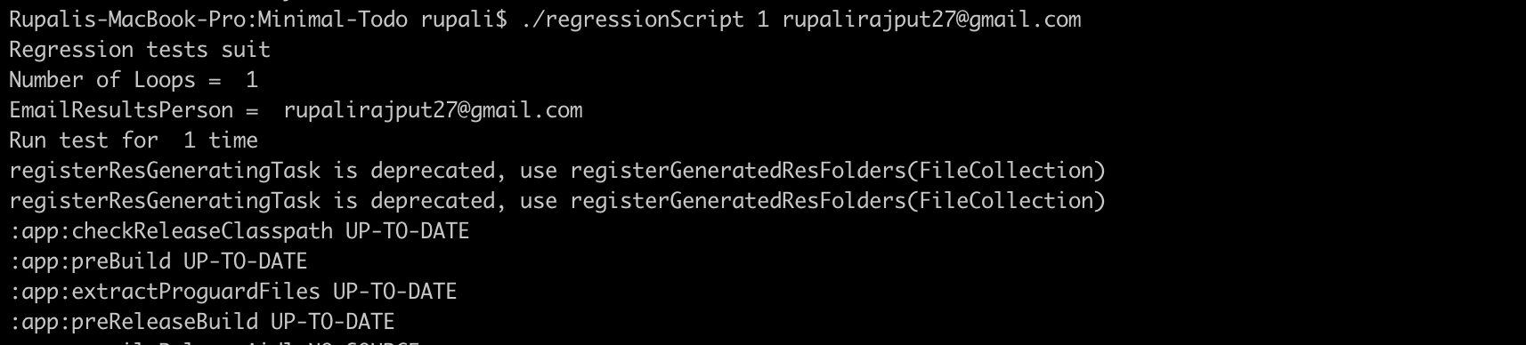
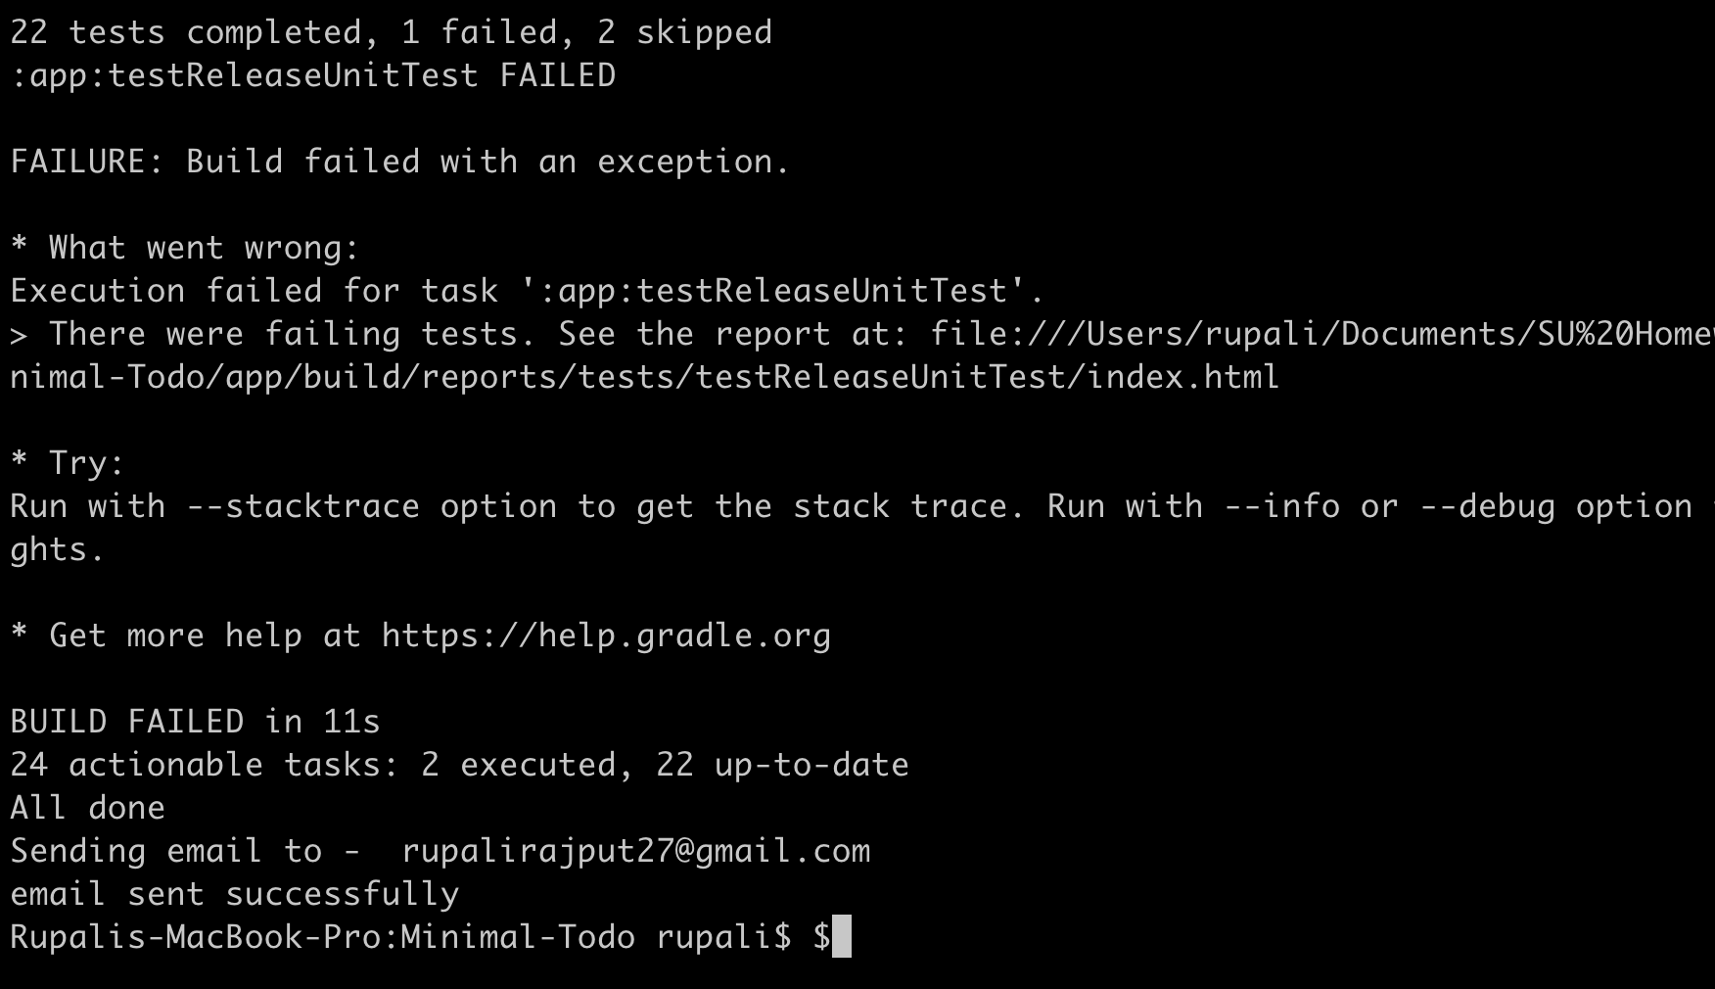
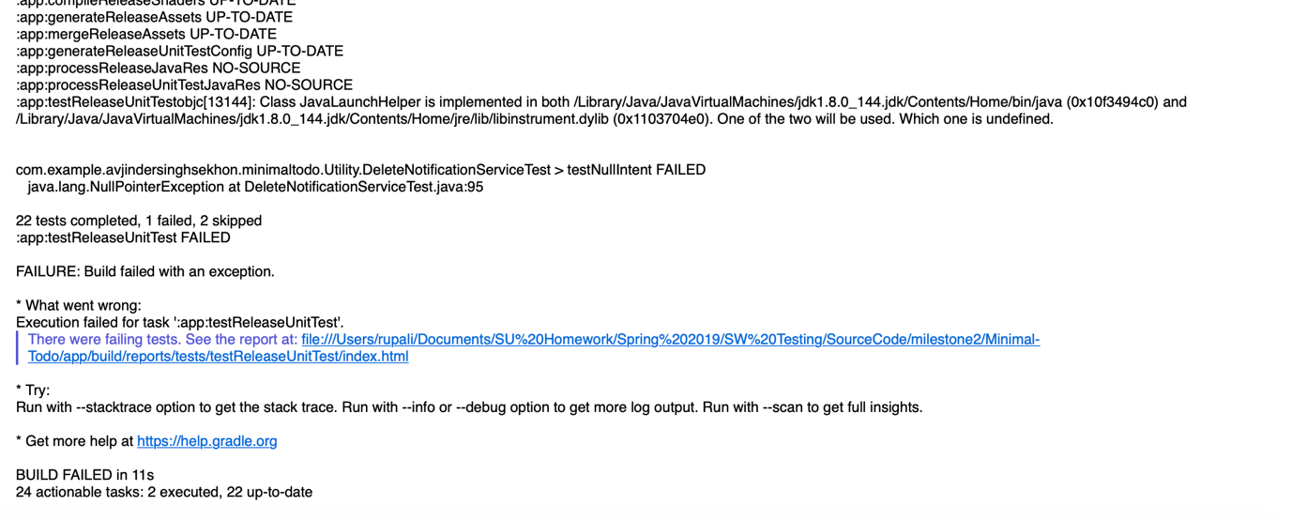
Regression Testing
Used bash script to loop over running android tests.
Can run the tests using command (‘./gradlew testRelease’)
Include python script to send email and call it from bash script.

Slide 5
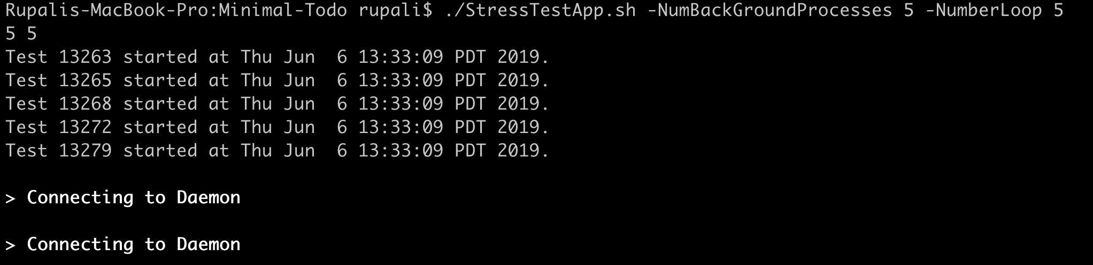
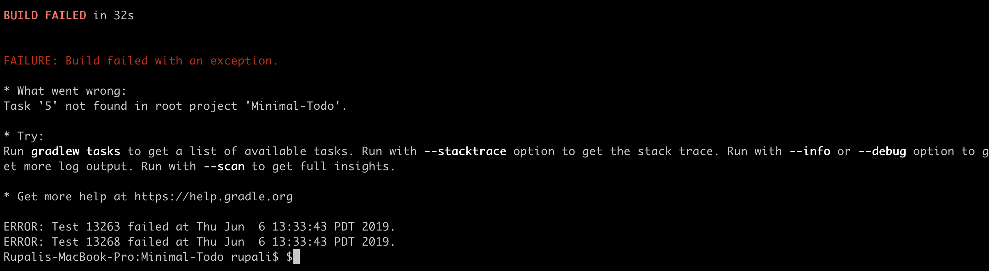
Stress Testing
The main goal of the stress testing was to reveal
application bugs under high load conditions.
We identified the application’s weak points such as
synchronization issues, memory leaks, and race conditions.
Also, we covered different time frames:
a one-time short-term load on the system
./StressTestApp.sh -NumBackGroundProcesses 5 -NumberLoop 5 (It takes around 32secs)
a one-time long-term load on the system,
./StressTestApp.sh -NumBackGroundProcesses 100 -NumberLoop 100 (It takes around 115mins)

Slide 6
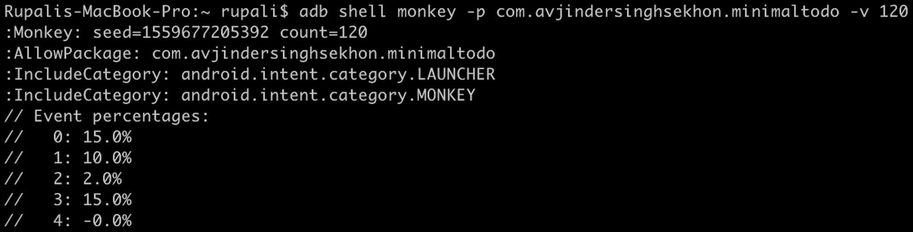
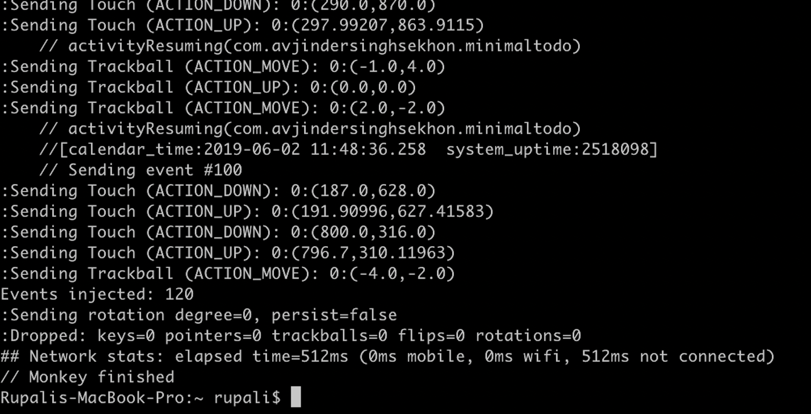
Monkey Testing
While doing this testing, we learned that it is an
effective way to identify some out-of-the-box errors.
The randomness of monkey testing makes it a good
way to find major bugs that can break the entire system.
The setup of monkey testing was quite easy.
Its syntax : `adb shell monkey`
We ran this command from android shell environment:
`$ adb shell monkey [options] <event-count>`
[options] = If we specify no options then it will
send events to all any packages installed on
your target, otherwise just mentioned package.
<event-count> = It is number of random events
you want to send to it.

Slide 7
Experiences and Lessons Learned
We faced lot of challenges surrounding the infrastructure and using several tools for the first time while doing this android application testing.
Understood and utilized the use of mock objects, fake objects and then how to control the behavior of the mocks to test for all possible cases.
Another learning was to understand how to trigger and build test cases for the entire project.
Also, we learnt that tests are not a cover for badly written code. We had to change several classes to get them to be test compatible.

